Slide 1
Volumetric Frequency Histogram Coarse Graining
Sanyam * Stefano
May 1st 2023

Slide 2
Rule Used (same for all following simulations)
rule = [[(0.451, 0.713, 0), (0.449, 0.663, 1), (0.191, 0.52, 1), (0.089, 0.296, 0)], [(0.332, 0.51, 0), (0.084, 0.307, 0), (0.182, 0.465, 1)], [(0.799, 0.902, 0), (0.303, 0.456, 0), (0.835, 0.984, 1)]]

Slide 3
HD (200x200 grid)

Slide 4
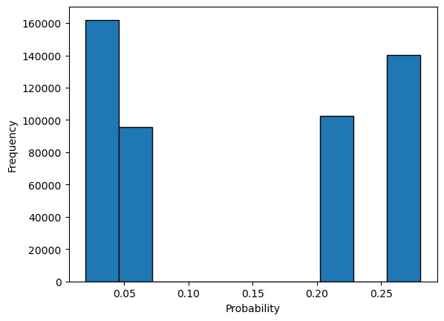
FHCG 0.03

Slide 5
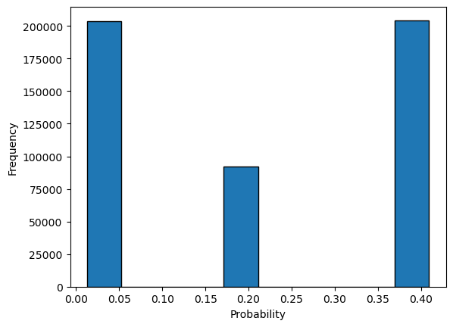
FHCG 0.013

Slide 6
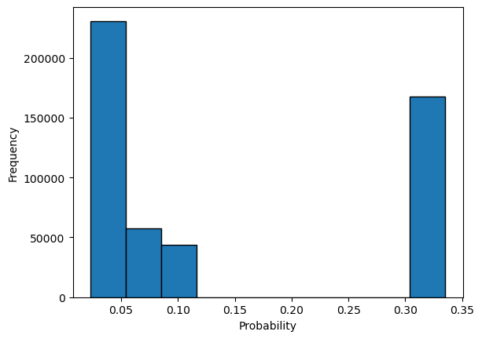
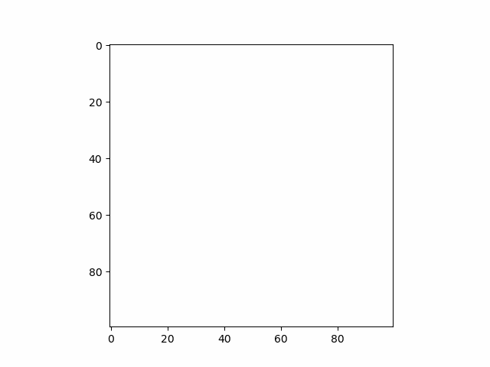
FHCG 0.023

Slide 7

FHCG 0.033

Slide 8
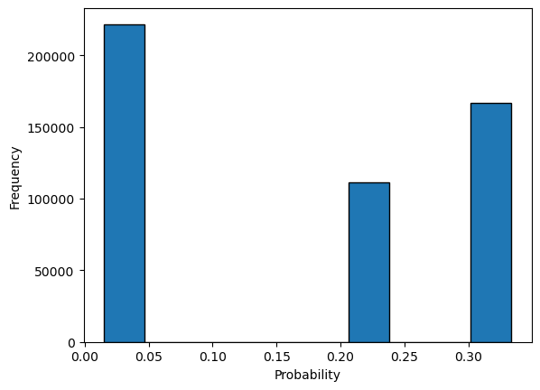
FHCG 0.053

Slide 9
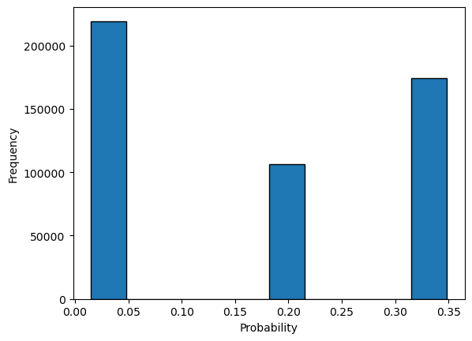
FHCG 0.063

Slide 10
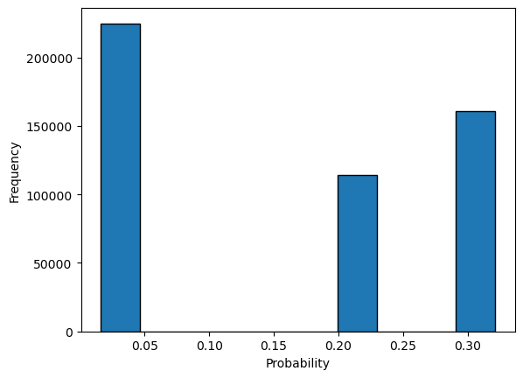
FHCG 0.073

Slide 11
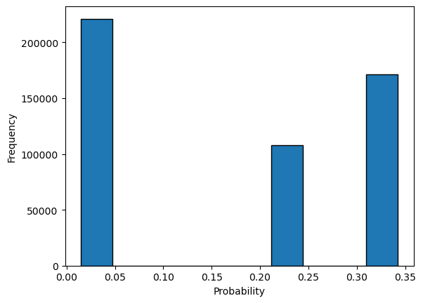
FHCG 0.83

Slide 12
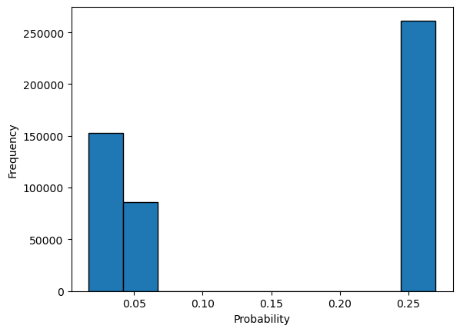
FHCG 0.093

Slide 13
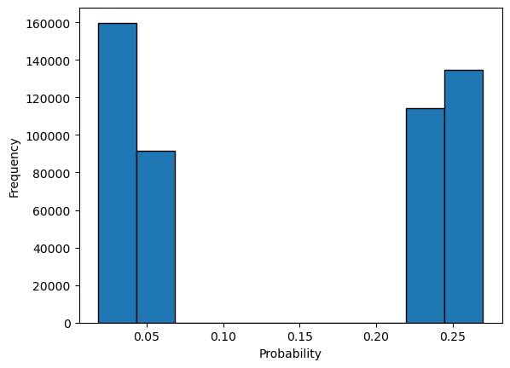
FHCG 0.103

